Slide 1
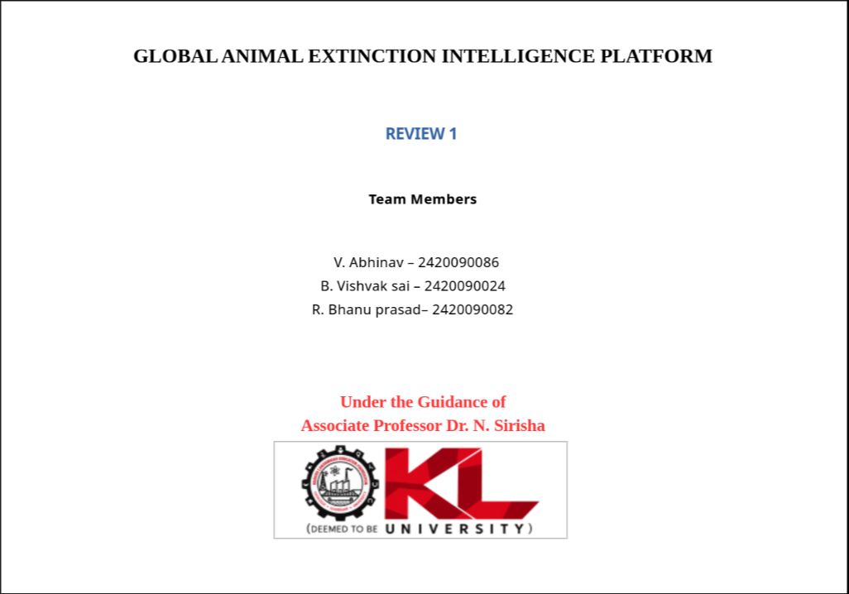
GLOBAL ANIMAL EXTINCTION INTELLIGENCE PLATFORM
REVIEW 1
Team Members
V. Abhinav – 2420090086
B. Vishvak sai – 2420090024
R. Bhanu prasad– 2420090082

Slide 2
Abstract
Animal extinction is a major environmental problem caused by factors such as habitat loss, climate change, illegal hunting, pollution, and other human activities. However, information about endangered species and their threats is often available across different sources, making it difficult to analyze and understand. The Global Animal Extinction Intelligence Platform is a centralized web-based system for collecting and presenting animal conservation information. It uses data collection, data integration, data analytics, and artificial intelligence techniques to analyze species information, population trends, threats, and geographical distribution. Interactive dashboards and maps are used to visualize the processed information. The platform aims to identify trends and provide useful insights about species at risk.

Slide 3
Introduction
Animal species are increasingly threatened by habitat loss, climate change, pollution, and illegal hunting. However, biodiversity data is scattered across multiple sources, making it difficult to understand species and their extinction risks. The Global Animal Extinction Intelligence Platform provides a centralized system to collect, analyze, and visualize this data using data analytics, interactive visualization, AI techniques, and ELT (Extract, Load, Transform). In the proposed ELT pipeline, raw data from different sources is first stored and then cleaned, integrated, and transformed for analysis and machine learning.

Slide 4
Architecture
Data Sources
(IUCN,Climate Data, etc)
Data Ingestion
ELT Processing
(Clean + Transform+Integrate)
Web Dashboard
(Charts + Maps)
AI/ML Model
Data Analytics

